Slide 1
What’s New in FlyBase
EDRC 2015, Heidelberg

Slide 2
Visualising interaction networks

Slide 3
Visualising interaction networks
Physical interactions

Slide 4
Visualising interaction networks
Genetic interactions

Slide 5
Visualising interaction networks
Genetic interactions
Collaboration with esyN (www.esyn.org) to add network diagrams

Slide 6
Visualising interaction networks
Physical interactions

Slide 7
Visualising interaction networks
Physical interactions

Slide 8
Visualising interaction networks
Physical interactions

Slide 9
Visualising interaction networks
Physical interactions

Slide 10
Visualising interaction networks
Physical interactions

Slide 11
Visualising interaction networks
Physical interactions

Slide 12
Visualising interaction networks
Physical interactions

Slide 13
Visualising interaction networks
Physical interactions
Common interactors highlighted in purple

Slide 14
Visualising interaction networks
Go to esyN website to:
Add interactions for other nodes
Build your own networks

Slide 15
Gene Groups: what are they?
Defined set of genes that are biologically related:
  Evolutionarily-related families e.g. actins
  Subunits of a complex e.g. ribosome
  Common molecular function e.g. lysine methyltransferases
Group membership based on published papers/reviews

Slide 16
Gene Groups: reports
Single page for each group:
  Lists members of the group
  Summarises key features of the group
  Provides links to get more detail

Slide 17
Gene Groups: reports

Slide 18
Gene Groups: reports

Slide 19
Gene Groups: reports

Slide 20
Gene Groups: reports

Slide 21
Gene Groups: reports

Slide 22
Gene Groups: accessing the data
Follow the links from the gene reports:
…
Search using the ‘Gene Groups’ tab on QuickSearch:
Browse the list of all Gene Group reports:
…
…

Slide 23
Human Disease Reports
Increasing number of fly papers on human disease models
Year:
1993
1998
2003
2008
2013
Drosophila articles containing “disease” in the abstract or title

Slide 24
Human Disease Reports
Single page for each disease
Bring together data relevant to modeling a human disease in flies
Provide a summary of published fly work in non-specialist terms
Provide links to other FlyBase reports and external databases for more detail

Slide 25


Human Disease Reports
Related diseases
Gene
Human disease descriptions
Phenotypes of fly models
Allele
NEW
Disease Report
Useful fly reagents
Orthology
Stock
Gene
DIOPT

Slide 26
Human Disease Reports: accessing the data
Follow the links from the gene reports:
…
Search using QuickSearch:

Slide 27
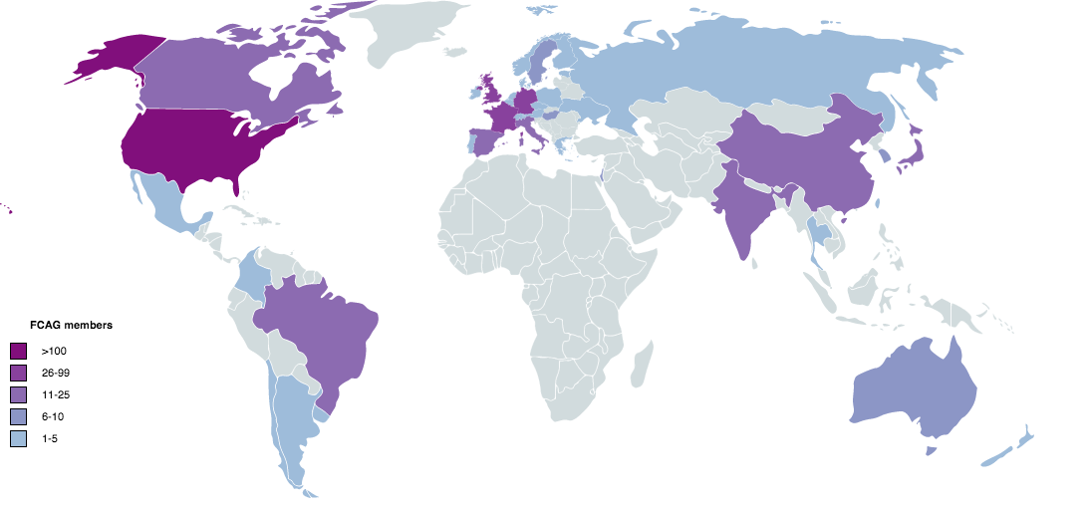
FlyBase Community Advisory Group (FCAG)
Launched September 2014
Surveys to get more feedback from the community about (potential) changes to the website
Over 550 members from more than 40 countries

Slide 28
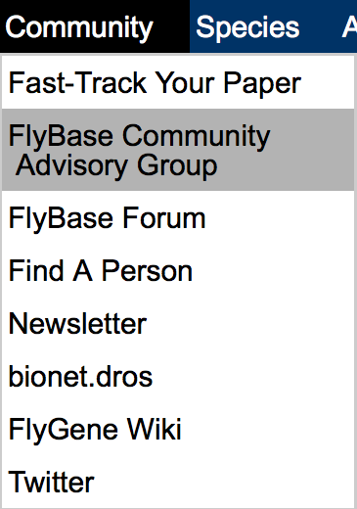
FlyBase Community Advisory Group (FCAG)
Results of the surveys and more information about FCAG are available on FlyBase:
The surveys have already helped with:
  Gene Group Report content/layout
  Default tracks on GBrowse
New members are welcome ! See the page above or http://tinyurl.com/FlyBaseCAG

Slide 29
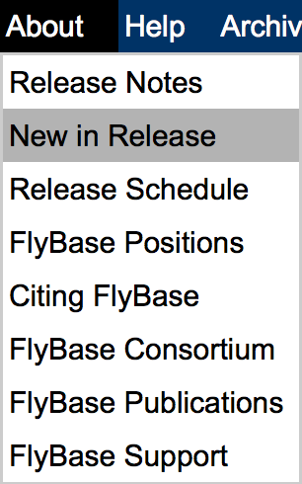
Want to know more ?
At the meeting:
  Exhibitor table, Großer Saal
After the meeting:
  ‘New in Release’ page lists major changes for each release:
Sign up for the Newsletter using the button on the Home page
‘Contact FlyBase’ link at the bottom of every page

